Slide 1

STOP!
Before you go any further, please go to the File menu and SAVE A COPY
Save a copy to YOUR OWN PERSONAL ONE DRIVE OR DEVICE.
Please ONLY edit YOUR COPY.
Do NOT try to edit or modify the original activity.
Thank you.

Slide 2
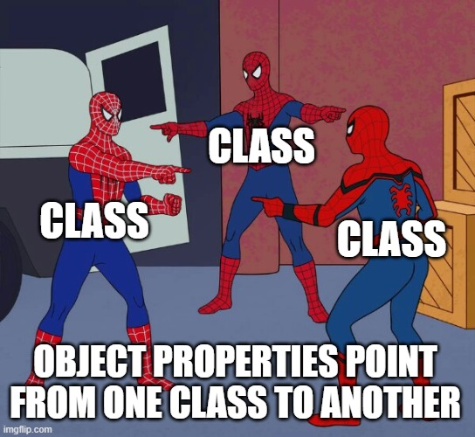

Classes and
Object Properties
This activity is designed to provide business analysts and others who are learning about the CEDS Ontology a visual way to explore how object properties are used to link classes to other classes and/or concept schemes.
Slides 3-11 provide instructions for the activity that follows.
Last updated 2026/09/14

Slide 3
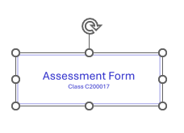

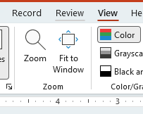
Activity Prerequisite:
Can you move, resize, and rotate shapes in PowerPoint?
If you click a shape and hold, the four arrows icon indicates you can drag the shape to a new location on the slide.
Click and drag to rotate
If you click on a shape and then let go, you’ll see icons indicating how to resize it or rotate it. This is useful if you need to zoom in to read the codes or shrink a shape to make it fit on the slide.
Pressing CTRL+Z will undo your last action
You can zoom in or out using the slider in the lower right corner of the screen.
You can also zoom in or out using the Zoom feature under the View menu at the top.
Click and drag any corner to resize

Slide 4
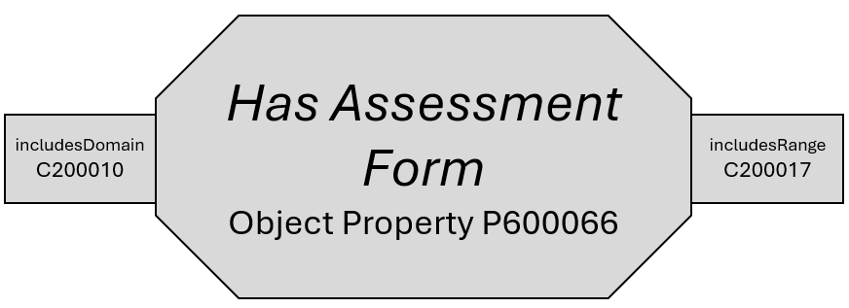
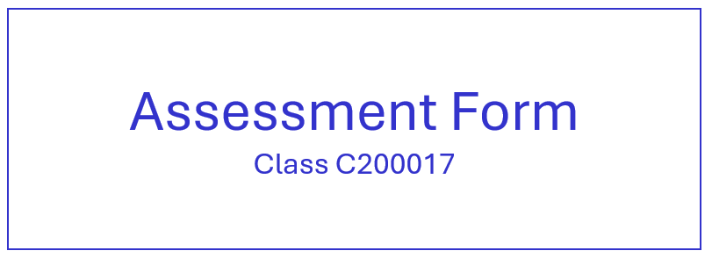
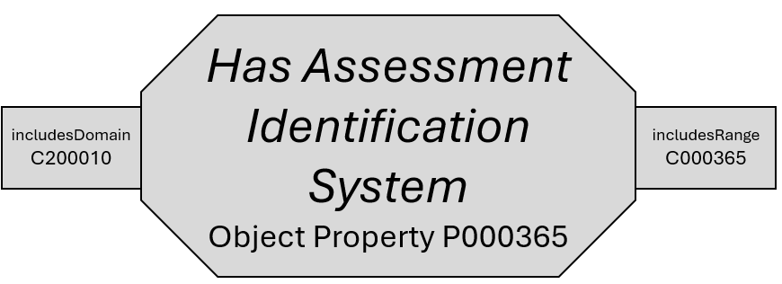
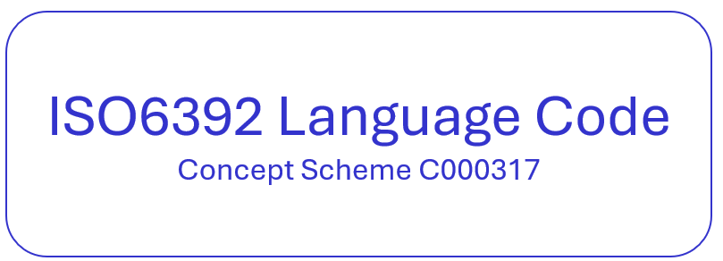
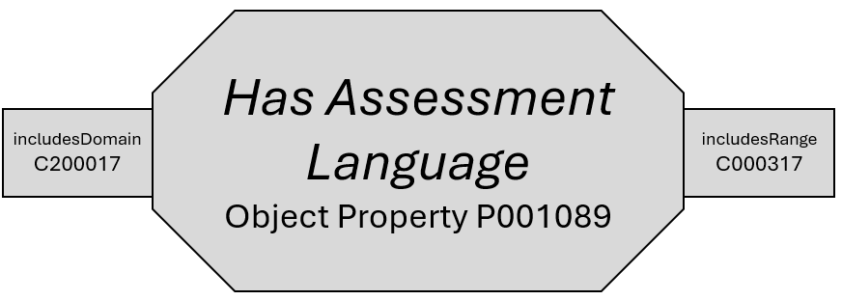
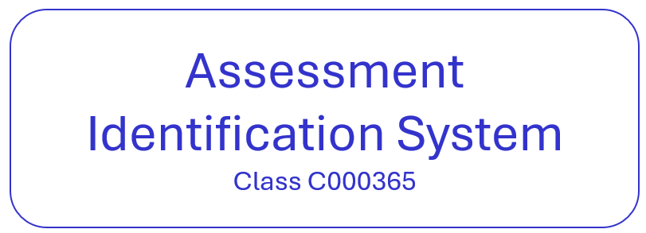
First, you’ll see a variety of shapes…
These shapes represent
classes,
concept schemes, and
object properties.

Slide 5
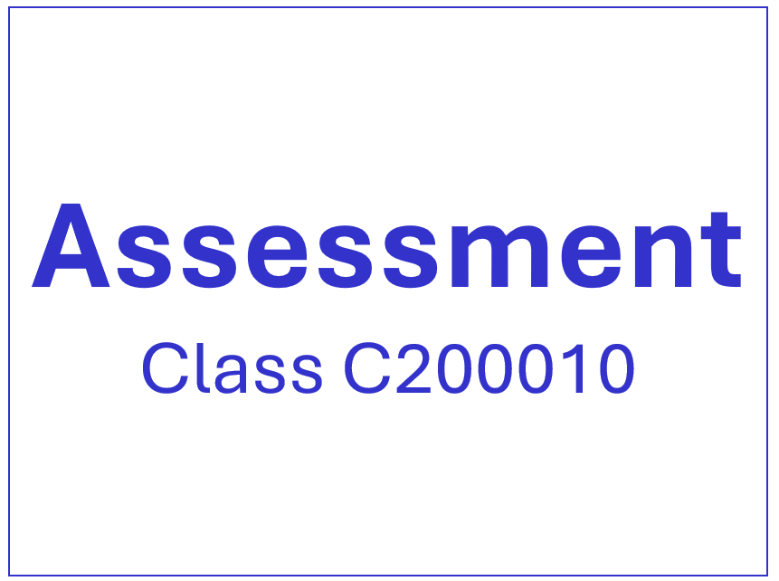
Rearrange the shapes to learn more about how object properties act as links between classes*.
The goal:
* Remember that concept schemes are a special kind of class. Some object properties will link a class to a class, and some will link a class to a concept scheme.

Slide 6
Object properties have domains and range(s).
The object property shapes will have little ‘tags’ sticking out to indicate the domain and range.
The domain is where the object property is coming from (the starting class) and the range is where it is going to (the destination class or concept scheme)

Slide 7


The codes must match!
These tags tell you which class can be connected to that side of the object property. You can only connect the Object Property to the class(es) listed on the tag.

Slide 8




Only Object Properties can connect classes.
The pattern will alternate between class and object property and class and object property. You’ll never connect an object property to an object property or put a class next to a class.
☺

Slide 9
Each parent class will have multiple branches
Each parent class will have 3 or 4 branches. It doesn’t matter which branch you start with or which is on top. What matters is seeing how object properties act as the links between the classes.

Slide 10
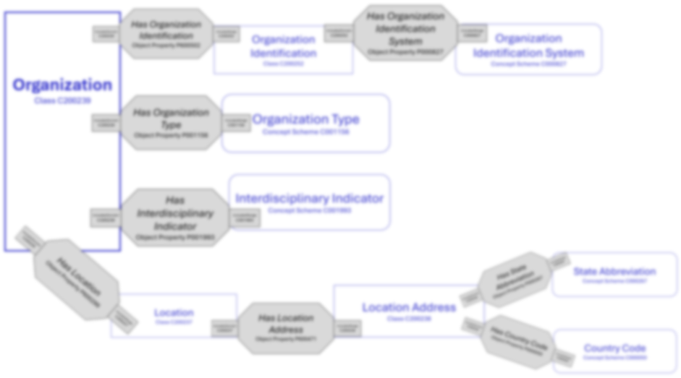
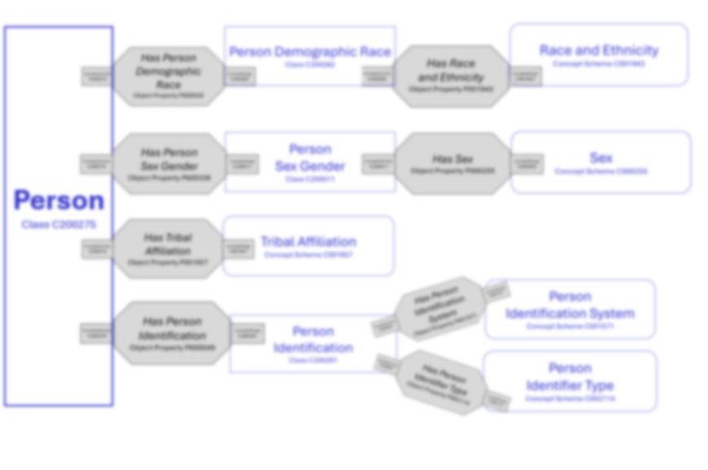
Branches will vary in size and complexity.
Branches will be of different lengths, and some branches will have sub-branches. All the shapes on the slide should be used by the end.
Parent Class

Slide 11

Slide 12 is related to COURSE data.
Slide 13 is related to ORGANIZATION data.
Slide 14 is related to PERSON data.
You may choose which one(s) to do.
The answer keys are located on slides 16-18
Ready to begin?

Slide 12
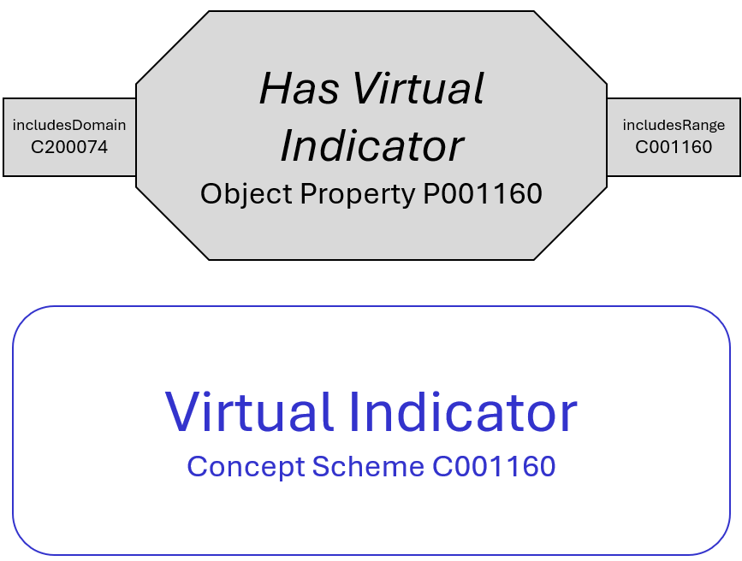
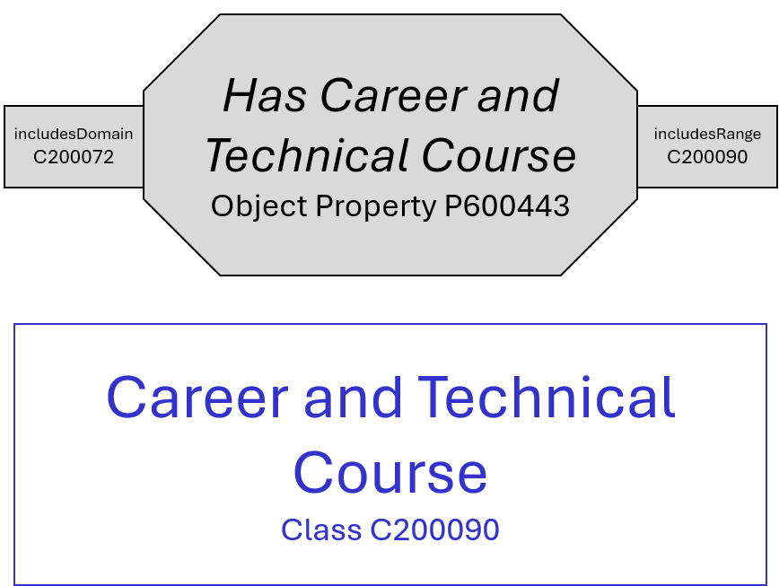
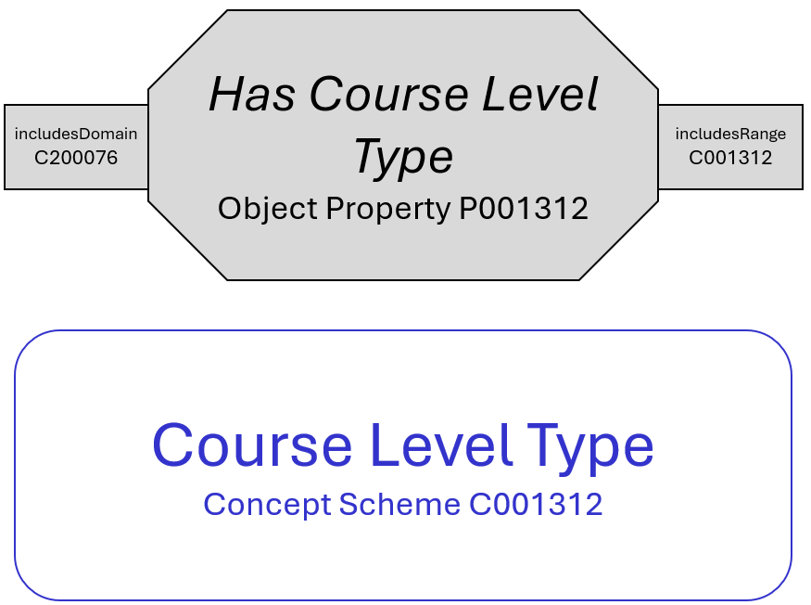
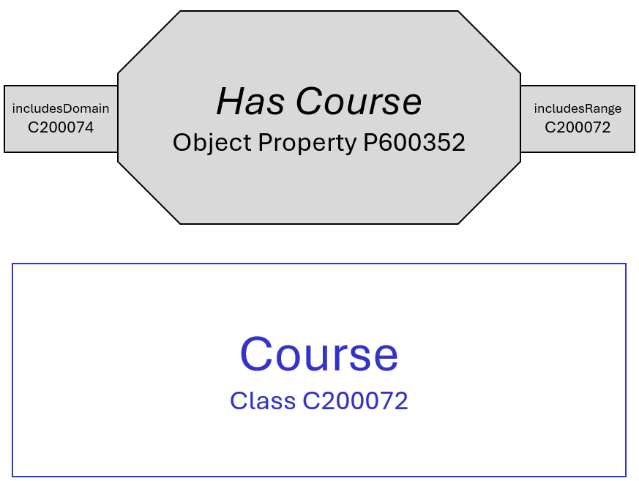
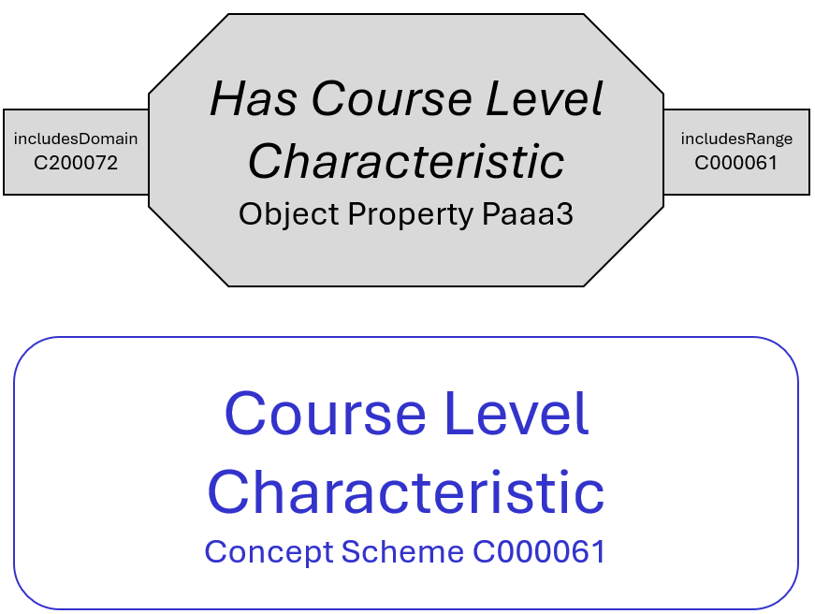
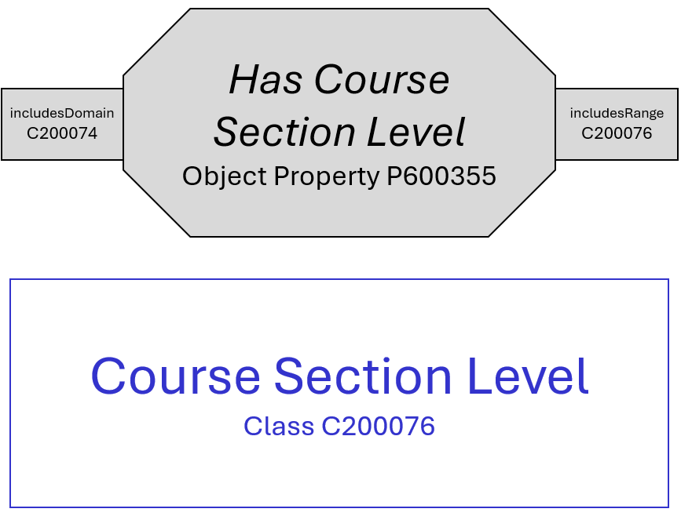
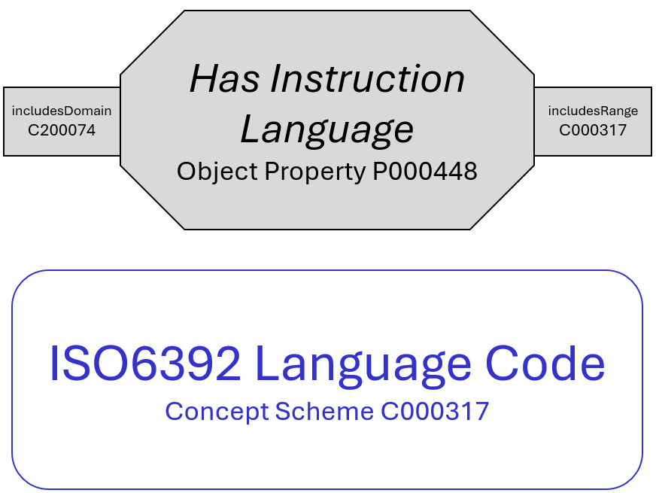
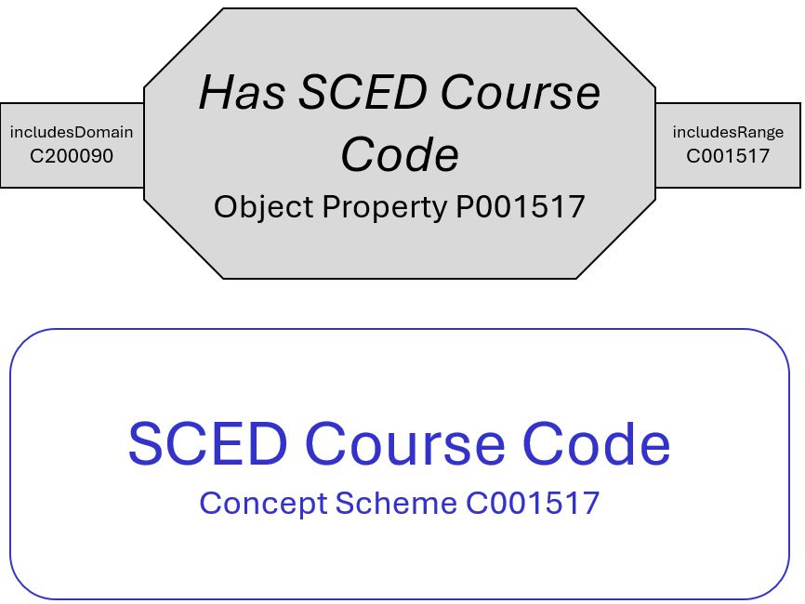
Course Section
Class C200074

Slide 13
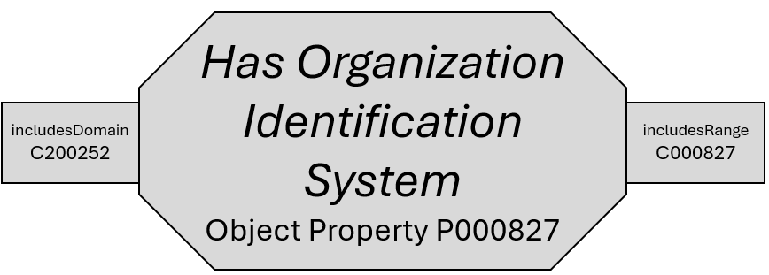
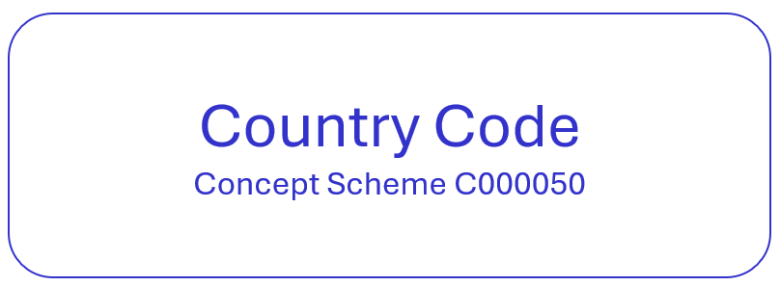
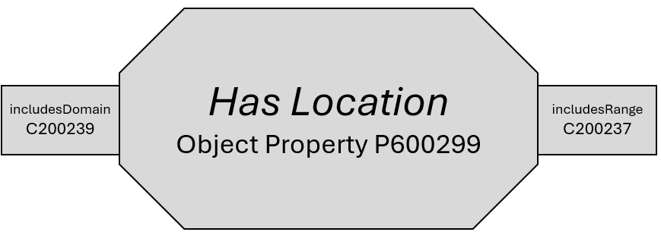
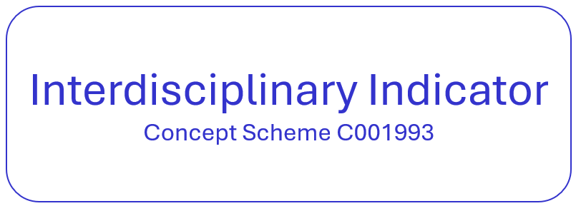
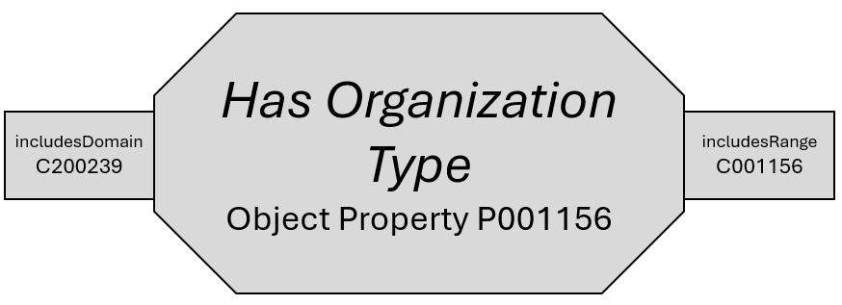

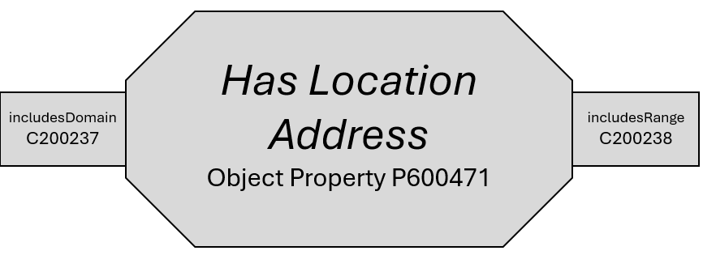
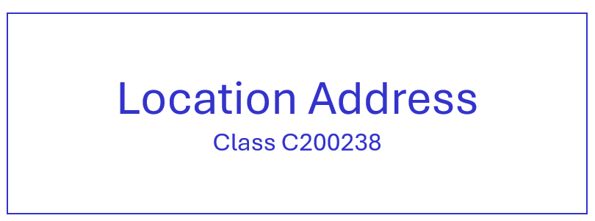
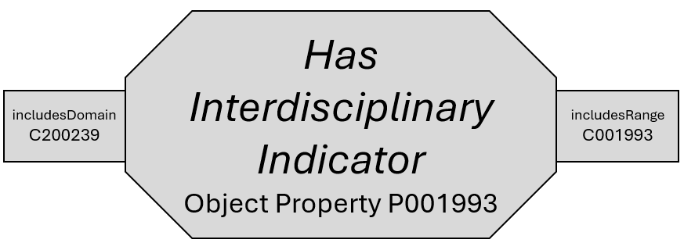
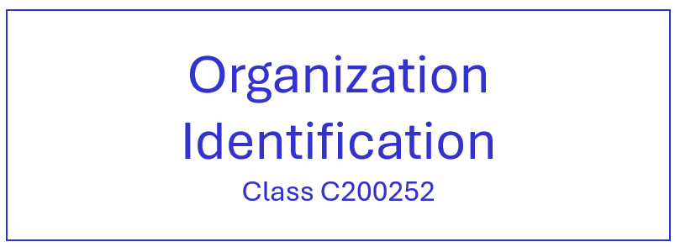
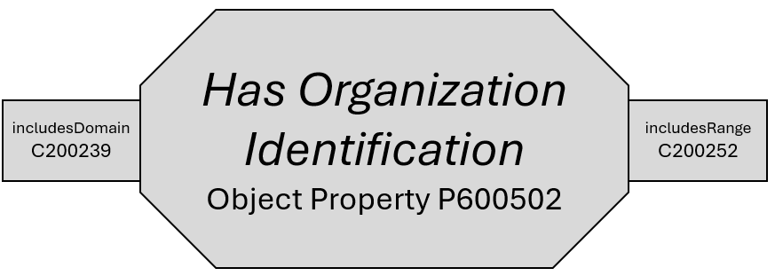
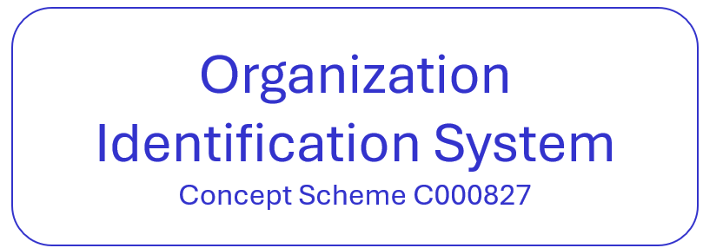
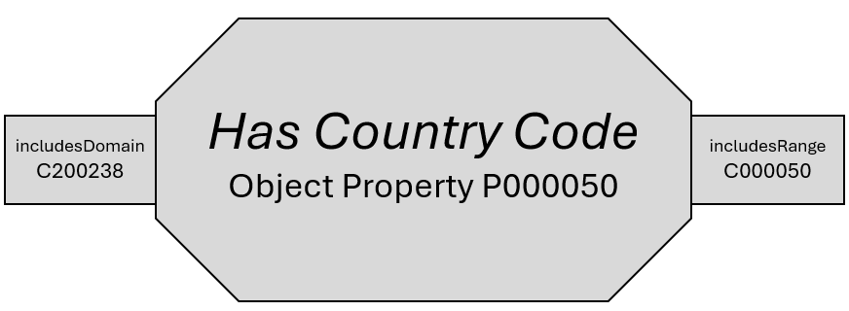
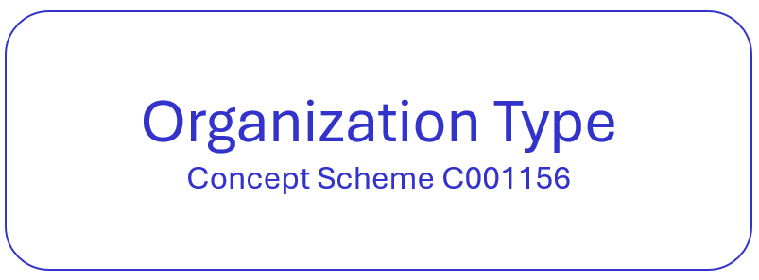
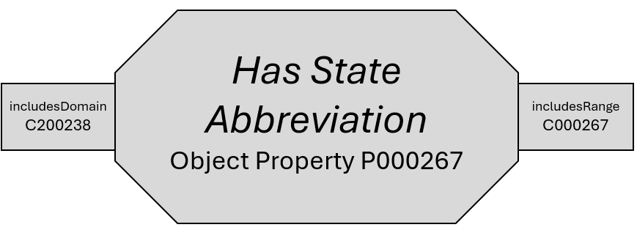
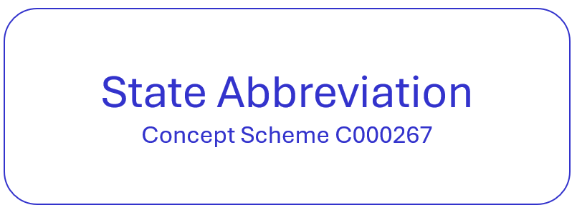
Organization
Class C200239

Slide 14
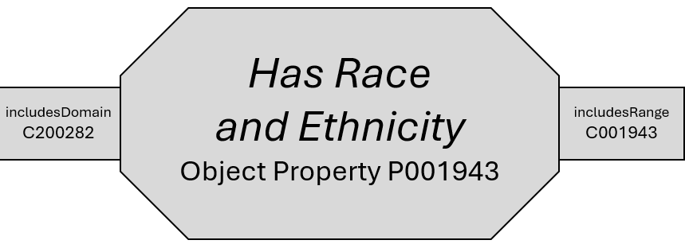
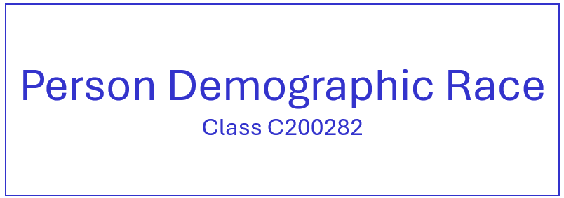
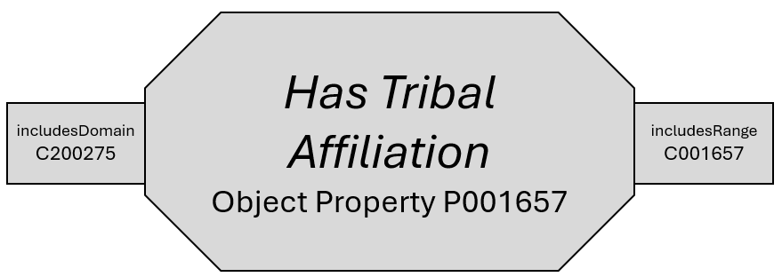
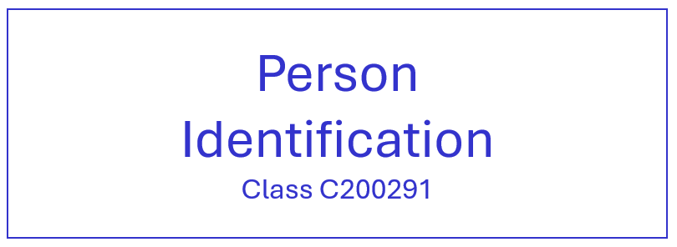
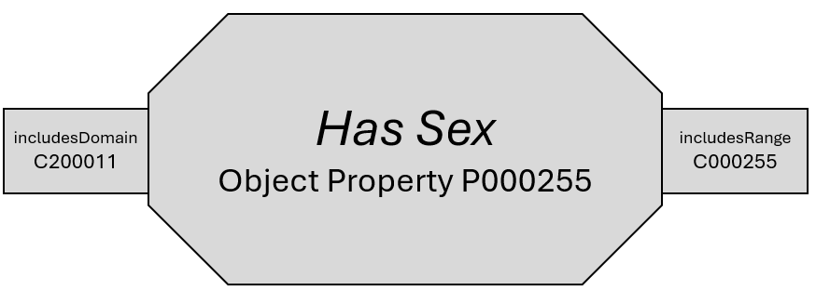
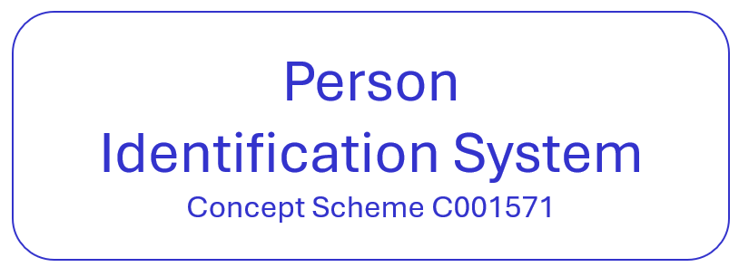
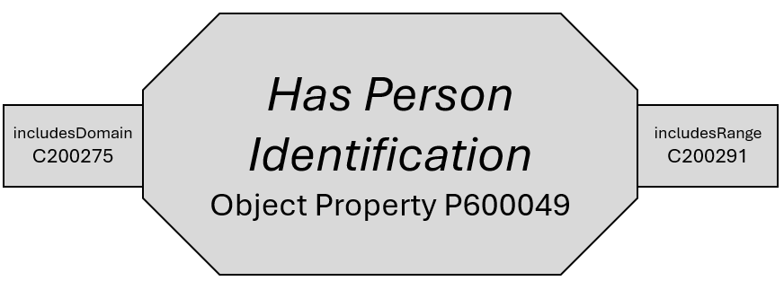
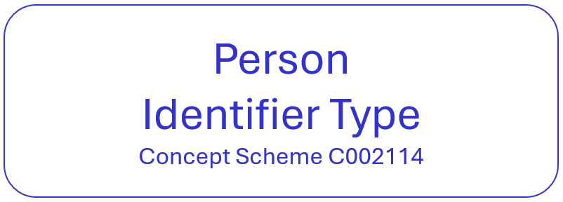
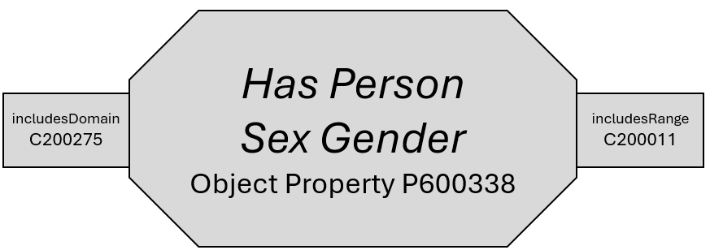
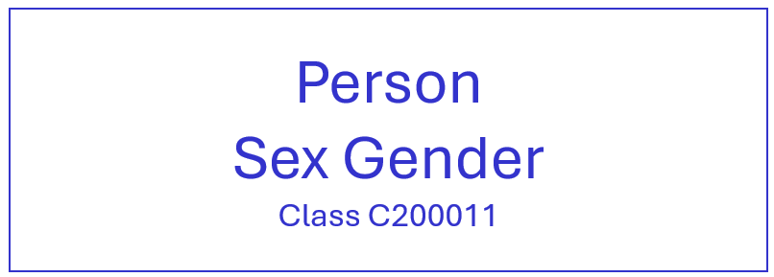
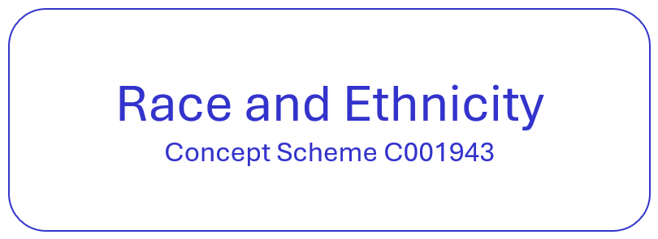
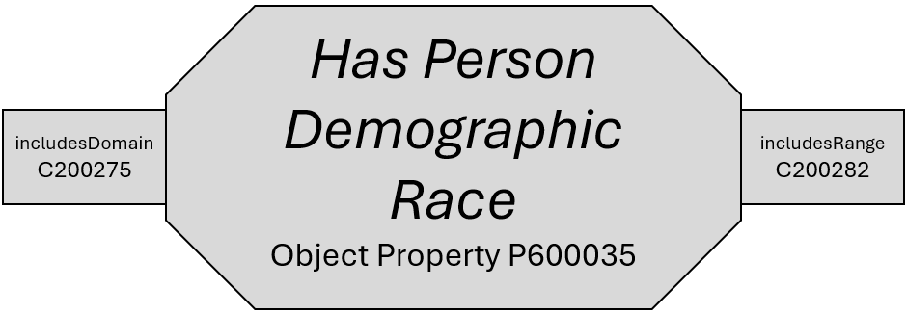
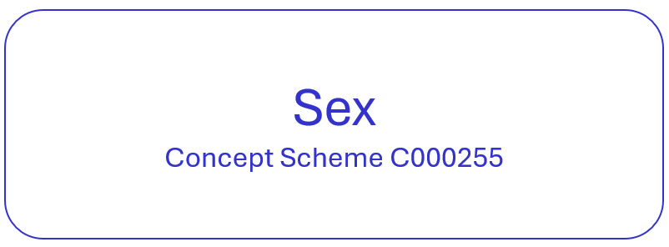
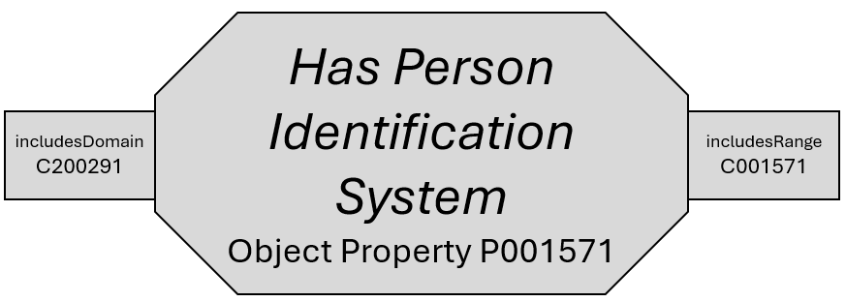
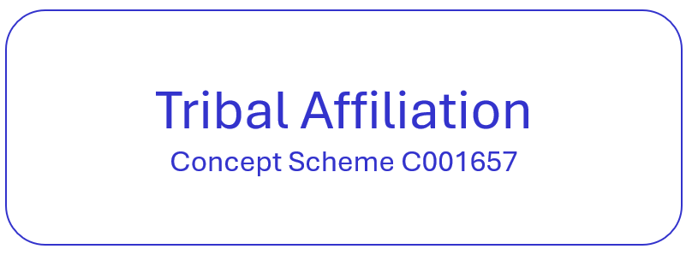

Person
Class C200275

Slide 15
Answer keys located after this slide

Slide 16

Answer Key for Course Section
ANSWER KEY

Slide 17

Answer Key for Organization
ANSWER KEY

Slide 18

Answer Key for Person
ANSWER KEY

